Slide 1
Data Structure and Algorithms Lecture 1
Lecture 1

Slide 2
What is Data Structure?
Data structure is a representation of data and the operations allowed on that data.
A data structure is a way to store and organize data in order to facilitate the access and modifications.
Data Structure are the method of representing of logical relationships between individual data elements related to the solution of a given problem.

Slide 3
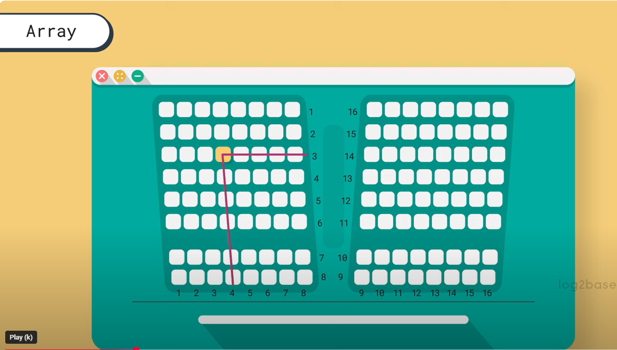

Slide 4
Basic Data Structure
Basic Data Structures
Linear Data Structures
Non-Linear Data Structures
Arrays
Linked Lists
Stacks
Queues
Trees
Graphs
Hash Tables
Notes:
4

Slide 5
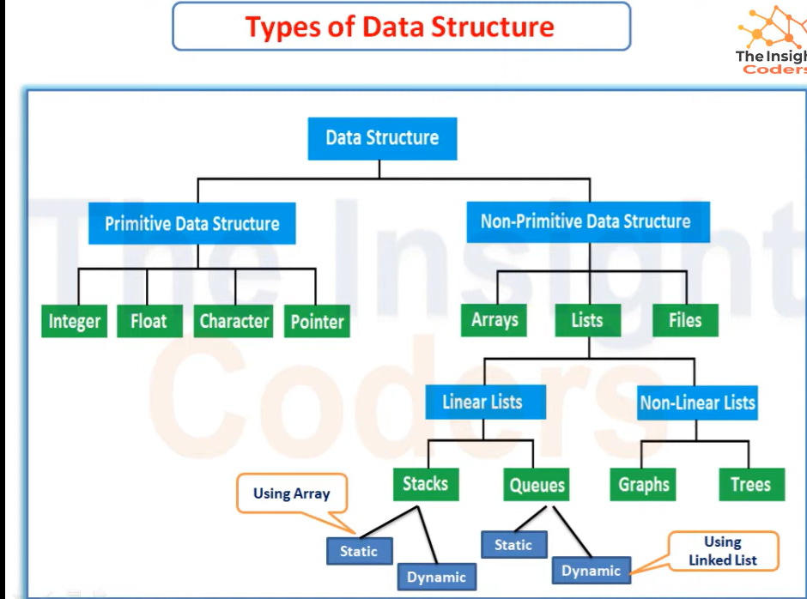

Slide 6
array
Linked list
queue
tree
stack

Slide 7
Types of Data Structure
Linear: In Linear data structure, values are arrange in linear fashion.
Array: Fixed-size
Linked-list: Variable-size
Stack: Add to top and remove from top
Queue: Add to back and remove from front
Priority queue: Add anywhere, remove the highest priority

Slide 8
Types of Data Structure
Non-Linear: The data values in this structure are not arranged in order.
Hash tables: Unordered lists which use a ‘hash function’ to insert and search
Tree: Data is organized in branches.
Graph: A more general branching structure, with less strict connection conditions than for a tree

Slide 9
Abstract Data Type and Data Structure
Definition:-
Abstract Data Types
An ADT is a collection of data (ADTs) stores data and allow various operations on the data to access and change it.
A mathematical model, together with various operations defined on the model and associated operations for manipulating that data
Data Structures
Physical implementation of an ADT
data structures used in implementations are provided in a language (primitive or built-in) or are built from the language constructs (user-defined)
Each operation associated with the ADT is implemented by one or more subroutines in the implementation

Slide 10
Type of Data Structures
Homogenous: In this type of data structures, values of the same types of data are stored.
Array
Non-Homogenous: In this type of data structures, data values of different types are grouped and stored.
Structures
Classes

Slide 11
Selection of Data Structure
The choice of particular data model depends on two consideration:
It must be rich enough in structure to represent the relationship between data elements
The structure should be simple enough that one can effectively process the data when necessary

Slide 12
Abstract Data Type
ADTs support abstraction, encapsulation, and information hiding.
Abstraction is the structuring of a problem into well-defined entities by defining their data and operations.
The principle of hiding the used data structure and to only provide a well-defined interface is known as encapsulation.

Slide 13
The Core Operations of ADT
Every Collection ADT should provide a way to:
add an item
remove an item
find, retrieve, or access an item
Many, many more possibilities
is the collection empty
make the collection empty
give me a sub set of the collection

Slide 14
No single data structure works well for all purposes, and so it is important to know the strengths and limitations of several of them

Slide 15
Stacks
Collection with access only to the last element inserted
Last in first out
insert/push
remove/pop
top
make empty
Data4
Top
Data3
Data2
Data1

Slide 16
Queues
Collection with access only to the item that has been present the longest
Last in last out or first in first out
enqueue, dequeue, front
priority queues and dequeue
Front
Back
Data1
Data2
Data3
Data4

Slide 17
List
A Flexible structure, because can grow and shrink on demand.
Elements can be:
Inserted
Accessed
Deleted
At any position
last
first

Slide 18
Tree
A Tree is a collection of elements called nodes.
One of the node is distinguished as a root, along with a relation (“parenthood”) that places a hierarchical structure on the nodes.
Root

Slide 19
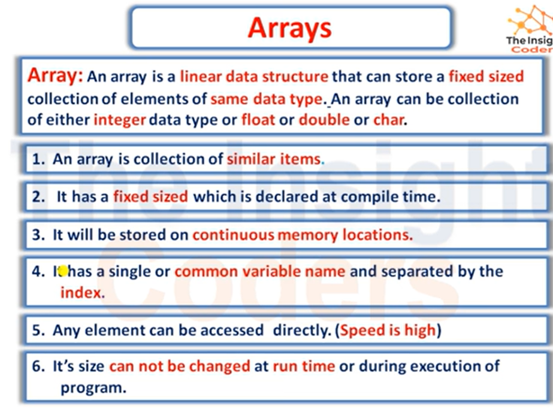

Slide 20
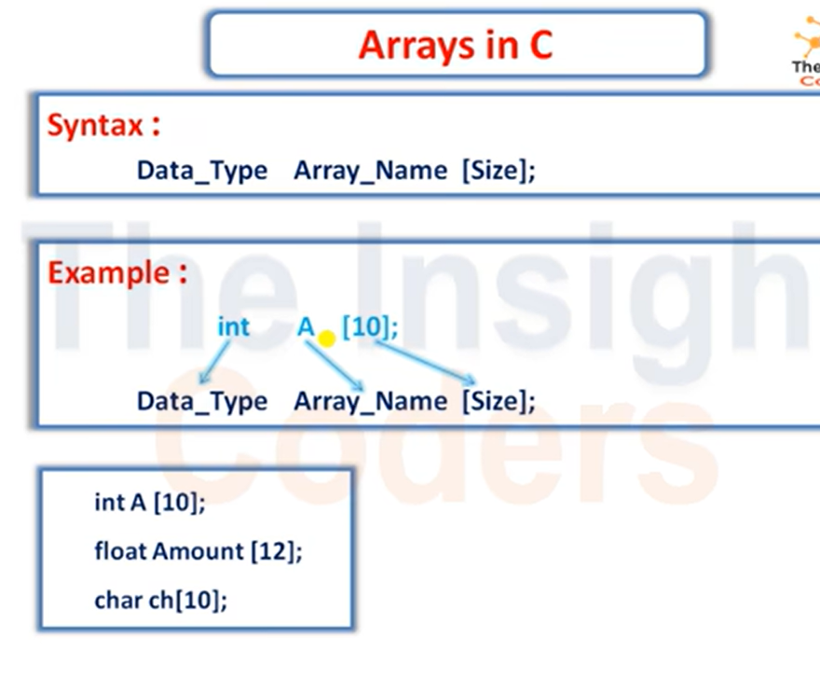

Slide 21
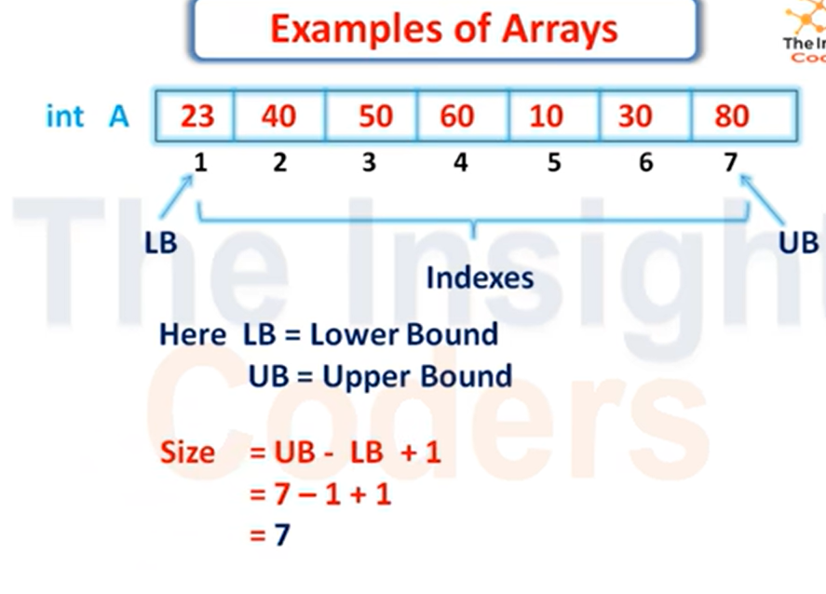

Slide 22
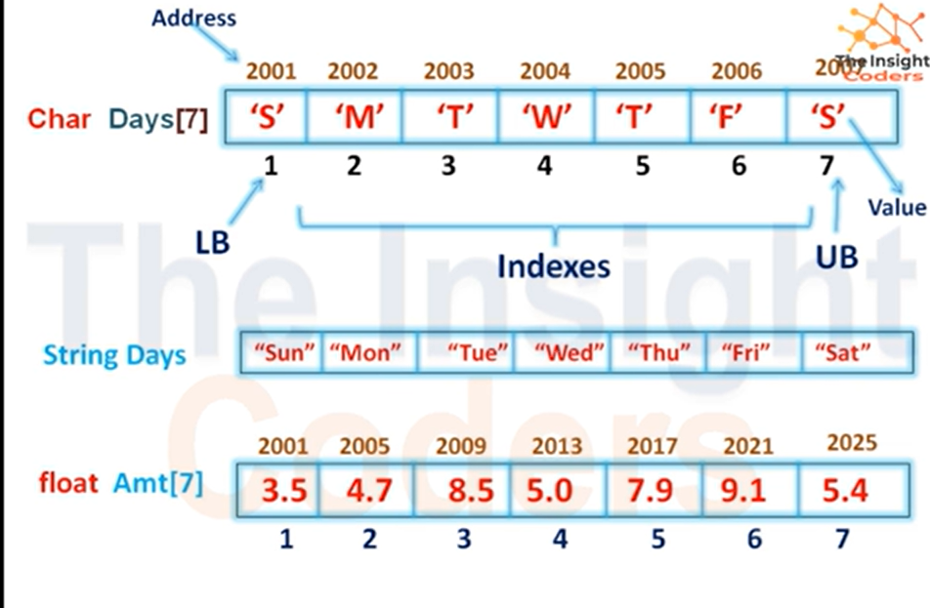

Slide 23
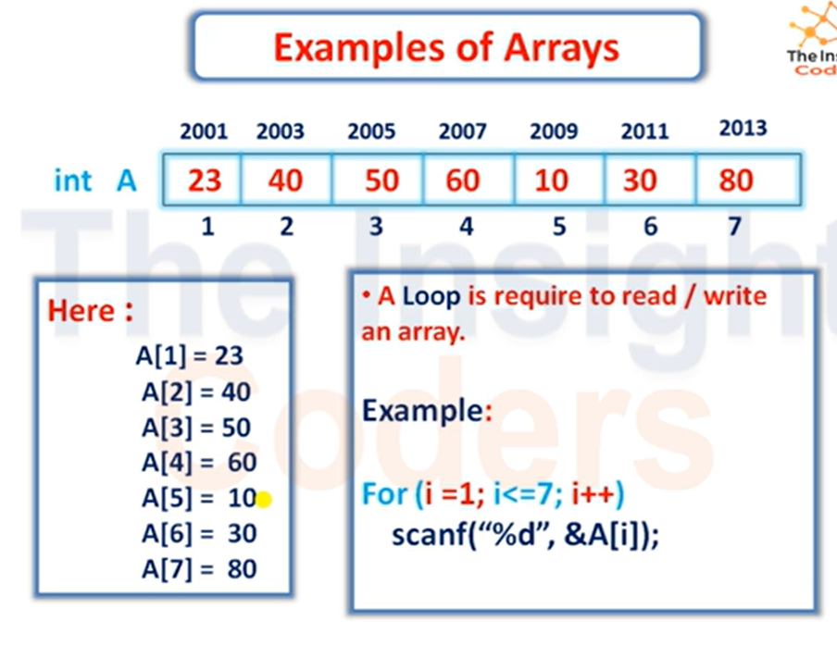

Slide 24
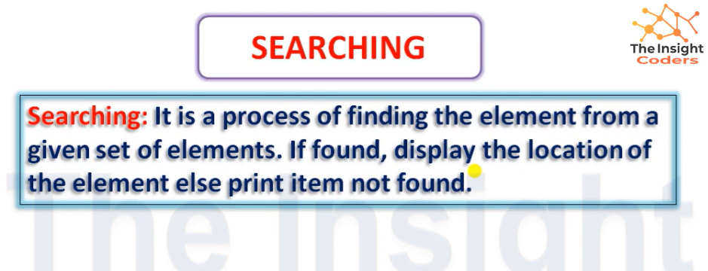
SEARCHING

Slide 25
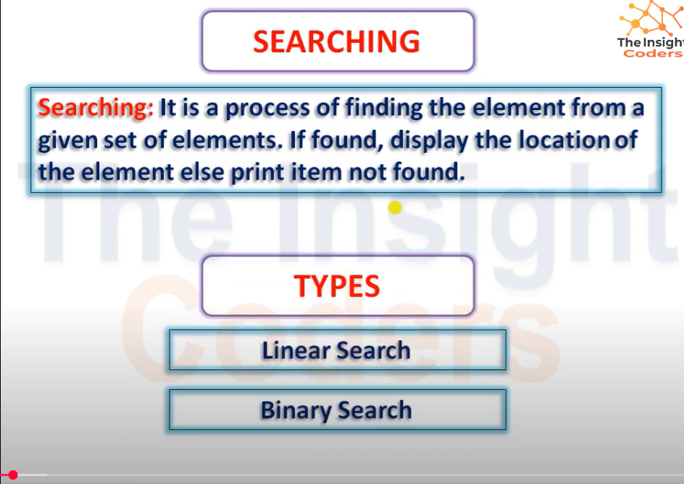

Slide 26
Linear Search Algorithm
Linear Search Algorithm
To search for the given element using linear search, follow the below approach:
Start traversing from the start of the dataset.
Compare the current element with the key (element to be searched).
If the element is equal to the key, return index.
Else, increment the index and repeat the step 2 and 3.
If we reach the end of the list without finding the element equal to the key, return some value to represent that the element is not found.

Slide 27
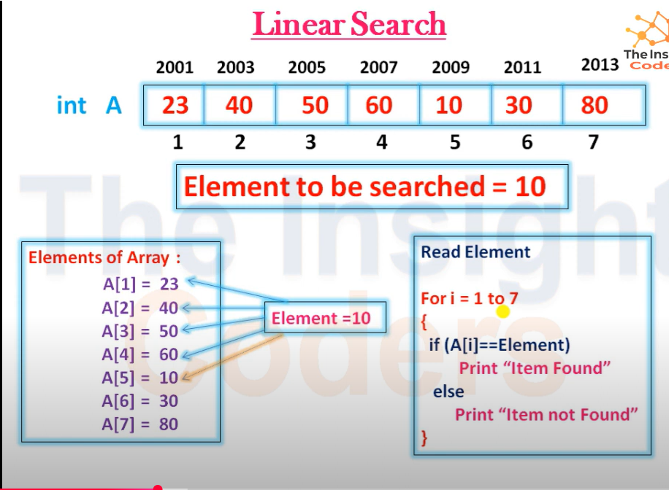

Slide 28
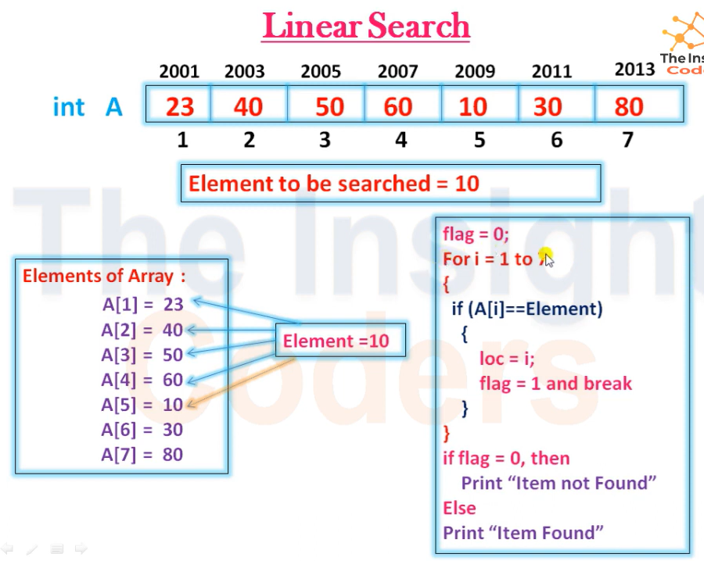

Slide 29
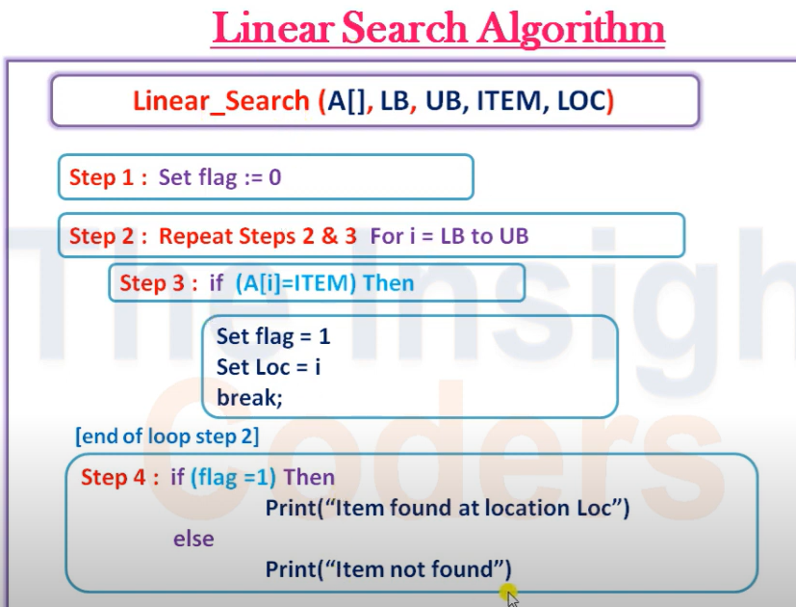

Slide 30
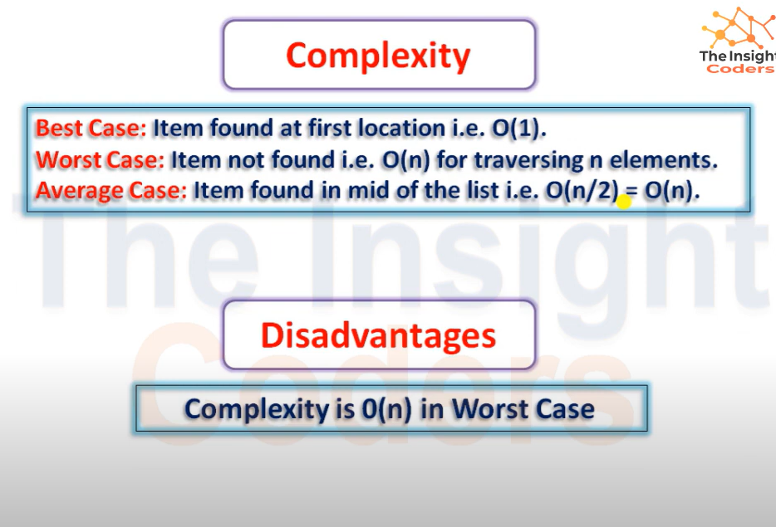

Slide 31
https://www.programiz.com/online-compiler/8P7Mdww4clQGx

Slide 32
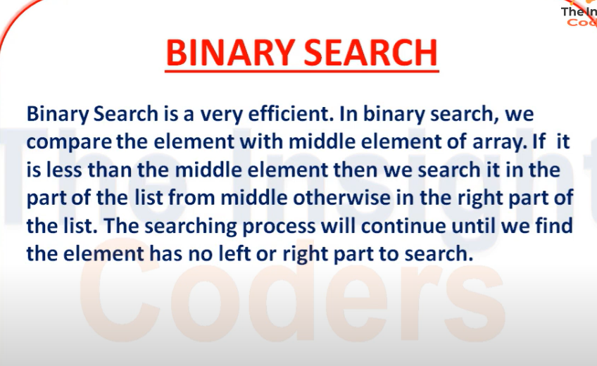

Slide 33
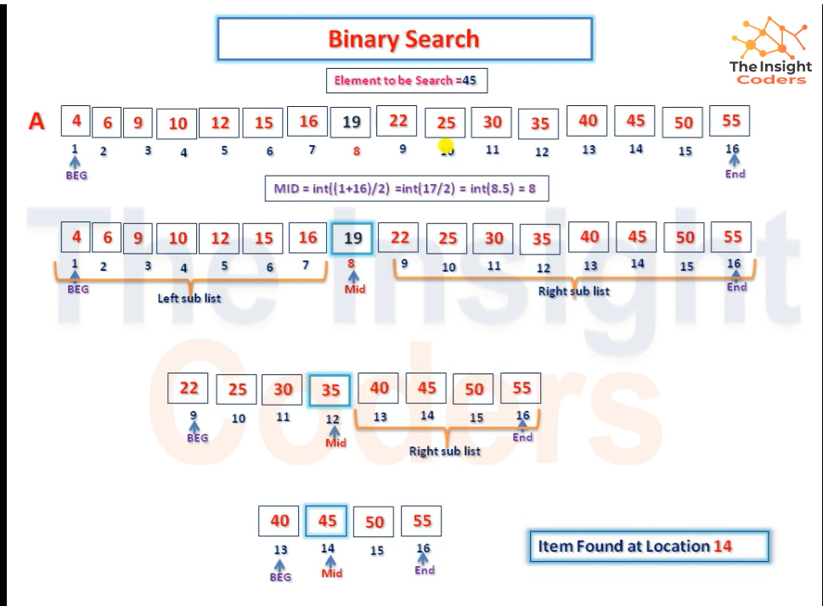

Slide 34
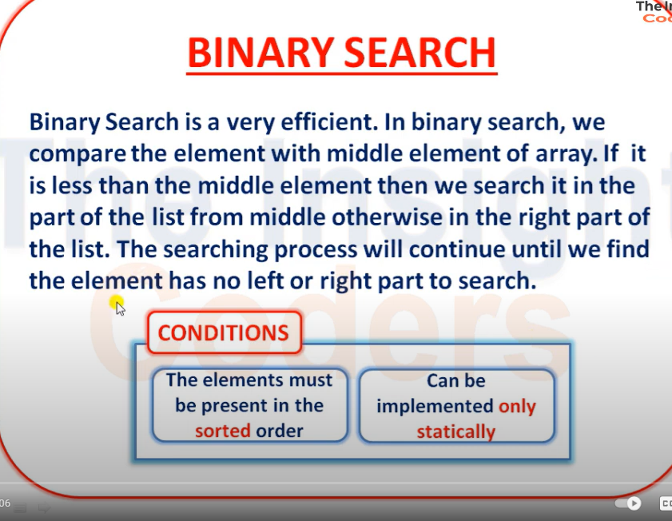

Slide 35
How to Implement Binary Search Algorithm?
The Binary Search Algorithm can be implemented in the following two ways
Iterative Binary Search Algorithm
Recursive Binary Search Algorithm
Iterative Binary Search Algorithm
we use a while loop to continue the process of comparing the key and splitting the search space in two halves.

Slide 36
Recursive Binary Search Algorithm
Create a recursive function and compare the mid of the search space with the key. And based on the result either return the index where the key is found or call the recursive function for the next search space.

Slide 37
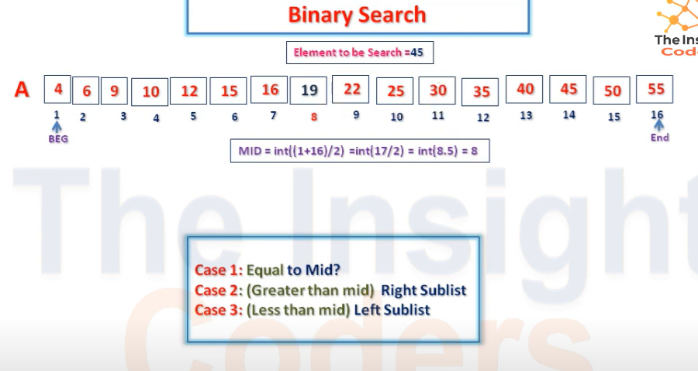

Slide 38
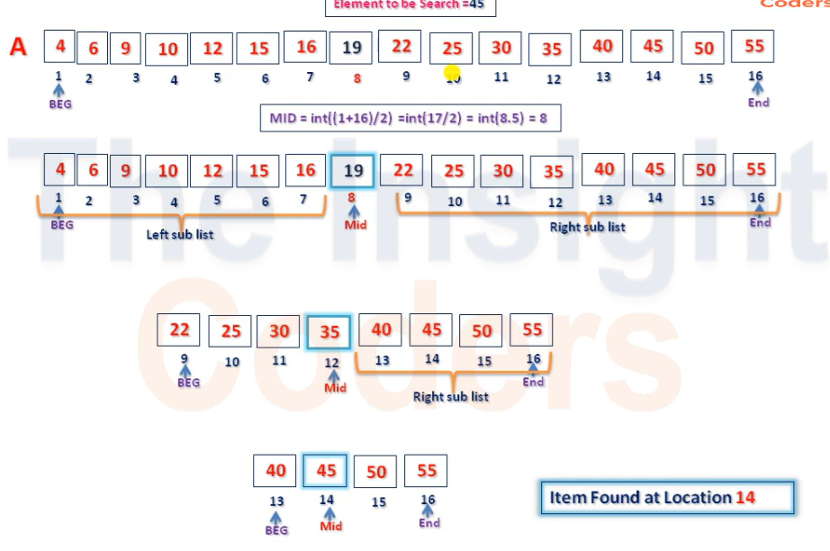

Slide 39
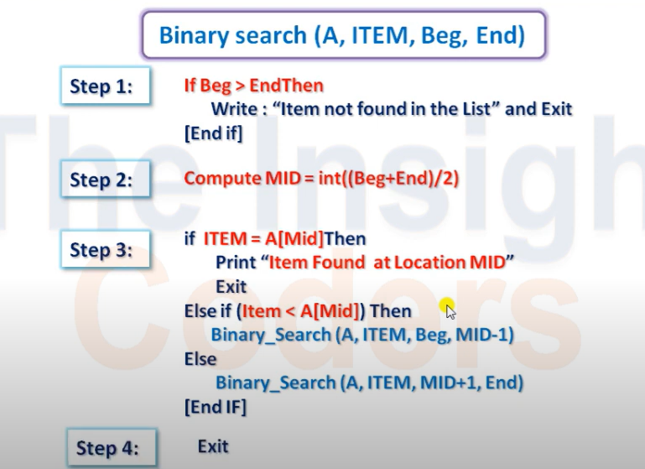

Slide 40
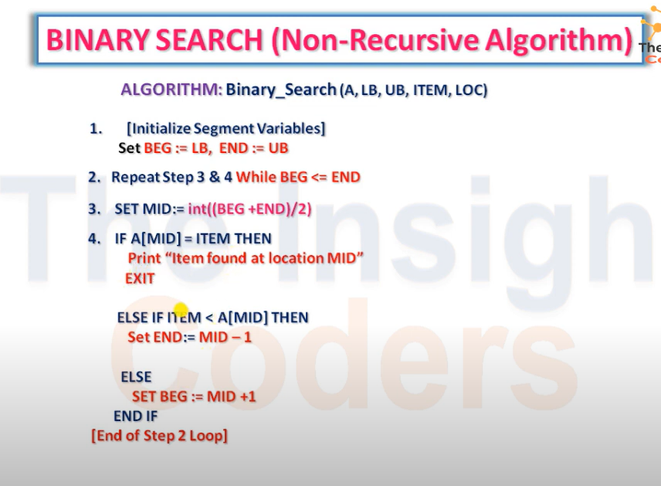

Slide 41
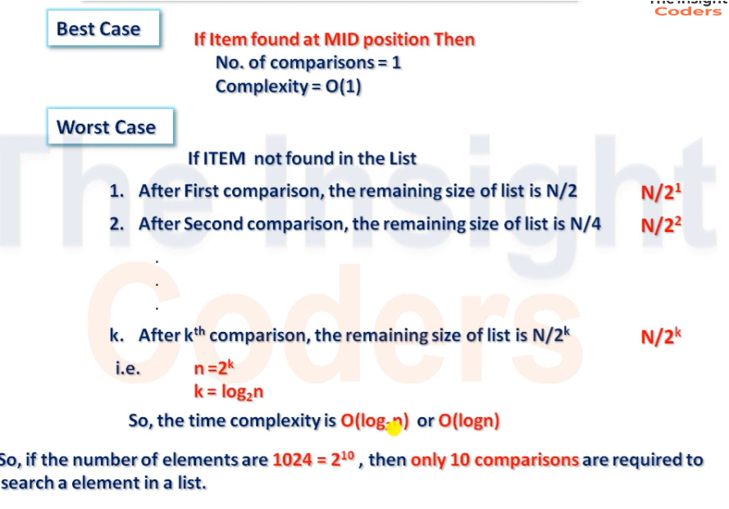

Slide 42
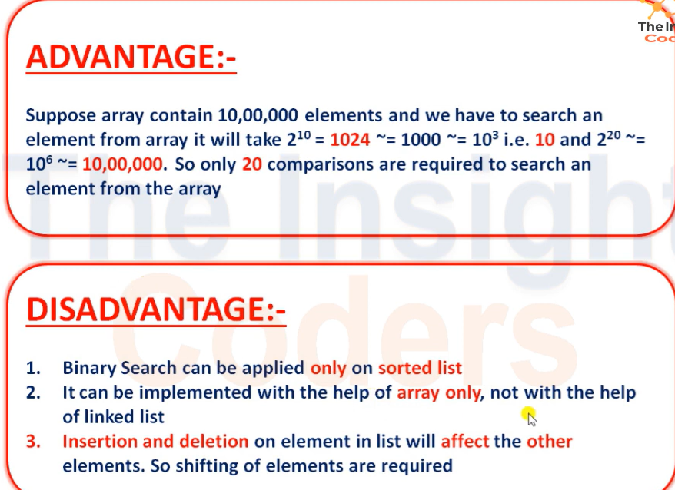

Slide 43
Link For Iterative Method
https://www.programiz.com/online-compiler/5K06KIwmo1mSN
Link For Recursive Method
https://www.programiz.com/online-compiler/3Hd9HvKqGLQ7z

Slide 44
Bubble Sort
https://www.programiz.com/online-compiler/5G4RFPq67N49O

Slide 45
Bubble Sort
Bubble sort is a simple sorting algorithm. This sorting algorithm is comparison-based algorithm in which each pair of adjacent elements is compared and the elements are swapped if they are not in order. This algorithm is not suitable for large data sets as its average and worst case complexity are of O(n²) where n is the number of items.

Slide 46
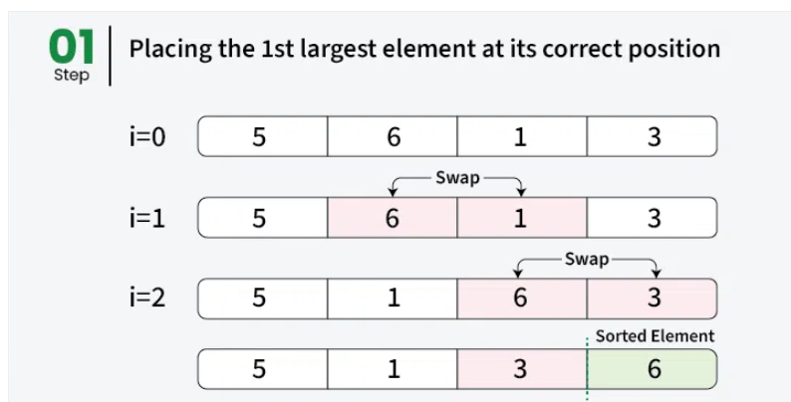

Slide 47
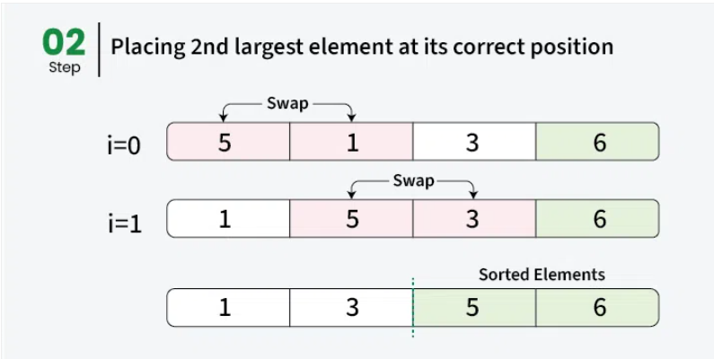

Slide 48
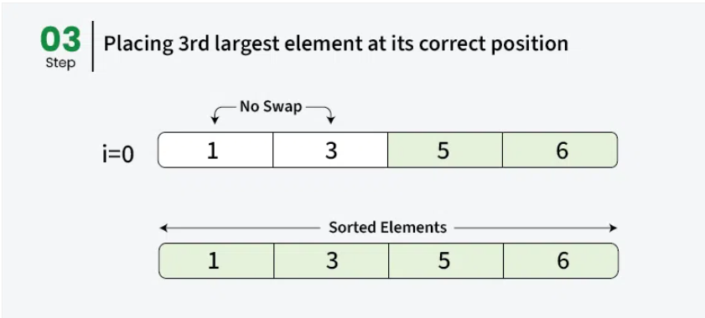

Slide 49
Bubble Sort Algorithm
Bubble Sort is an elementary sorting algorithm, which works by repeatedly exchanging adjacent elements, if necessary. When no exchanges are required, the file is sorted.
We assume list is an array of n elements. We further assume that swap function swaps the values of the given array elements.
Step 1 − Check if the first element in the input array is greater than the next element in the array.
Step 2 − If it is greater, swap the two elements; otherwise move the pointer forward in the array.
Step 3 − Repeat Step 2 until we reach the end of the array.
Step 4 − Check if the elements are sorted; if not, repeat the same process (Step 1 to Step 3) from the last element of the array to the first.
Step 5 − The final output achieved is the sorted array.

Slide 50
Selection Sort
Selection Sort is a comparison-based sorting algorithm. It sorts an array by repeatedly selecting the smallest (or largest) element from the unsorted portion and swapping it with the first unsorted element. This process continues until the entire array is sorted.
First we find the smallest element and swap it with the first element. This way we get the smallest element at its correct position.
Then we find the smallest among remaining elements (or second smallest) and swap it with the second element.
We keep doing this until we get all elements moved to correct position.

Slide 51
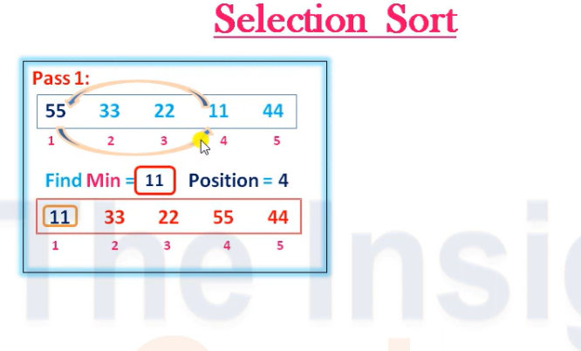

Slide 52
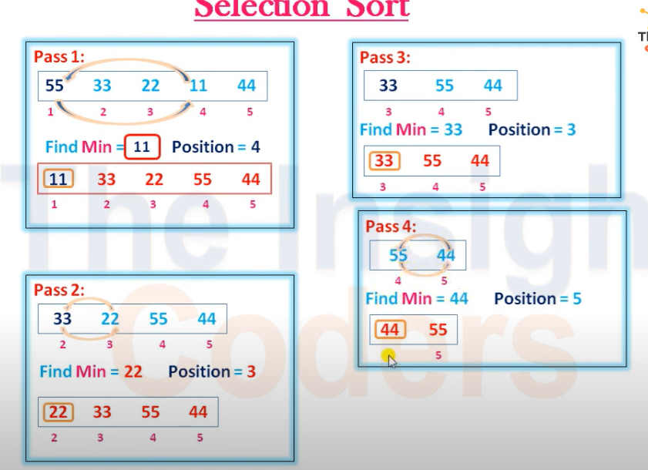

Slide 53
Complexity Analysis of Selection Sort
Time Complexity: O(n²) ,as there are two nested loops:
One loop to select an element of Array one by one = O(n)
Another loop to compare that element with every other Array element = O(n)
Therefore overall complexity = O(n) * O(n) = O(n*n) = O(n²)

Slide 54
https://www.programiz.com/online-compiler/11UE42shOR04F

Slide 55
Insertion Sort
Insertion sort is a simple sorting algorithm that works by iteratively inserting each element of an unsorted list into its correct position in a sorted portion of the list. It is like sorting playing cards in your hands. You split the cards into two groups: the sorted cards and the unsorted cards. Then, you pick a card from the unsorted group and put it in the right place in the sorted group.

Slide 56
Insertion Sort
Insertion sort works similar to the sorting of playing cards in hands. It is assumed that the first card is already sorted in the card game, and then we select an unsorted card. If the selected unsorted card is greater than the first card, it will be placed at the right side; otherwise, it will be placed at the left side. Similarly, all unsorted cards are taken and put in their exact place.

Slide 57
Algorithm
The simple steps of achieving the insertion sort are listed as follows -
Step 1 - If the element is the first element, assume that it is already sorted. Return 1.
Step2 - Pick the next element, and store it separately in a key.
Step3 - Now, compare the key with all elements in the sorted array.
Step 4 - If the element in the sorted array is smaller than the current element, then move to the next element. Else, shift greater elements in the array towards the right.
Step 5 - Insert the value.
Step 6 - Repeat until the array is sorted.

Slide 58
How to Implement Binary Search Algorithm?
The Binary Search Algorithm can be implemented in the following two ways
Iterative Binary Search Algorithm
Recursive Binary Search Algorithm

Slide 59
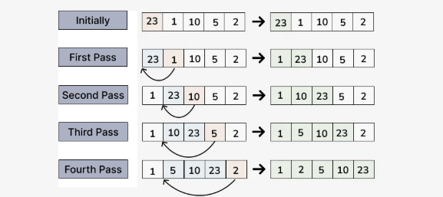

Slide 60
Merge Sort
https://www.programiz.com/online-compiler/8FWtM85rR9BAS

Slide 61
Merge Sort
Merge sort is a sorting algorithm that follows the divide-and-conquer approach. It works by recursively dividing the input array into smaller subarrays and sorting those subarrays then merging them back together to obtain the sorted array.
In simple terms, we can say that the process of merge sort is to divide the array into two halves, sort each half, and then merge the sorted halves back together. This process is repeated until the entire array is sorted.

Slide 62
How does Merge Sort work?
Merge sort is a popular sorting algorithm known for its efficiency and stability. It follows the divide-and-conquer approach to sort a given array of elements.
Here’s a step-by-step explanation of how merge sort works:
Divide: Divide the list or array recursively into two halves until it can no more be divided.
Conquer: Each subarray is sorted individually using the merge sort algorithm.
Merge: The sorted subarrays are merged back together in sorted order. The process continues until all elements from both subarrays have been merged.

Slide 63
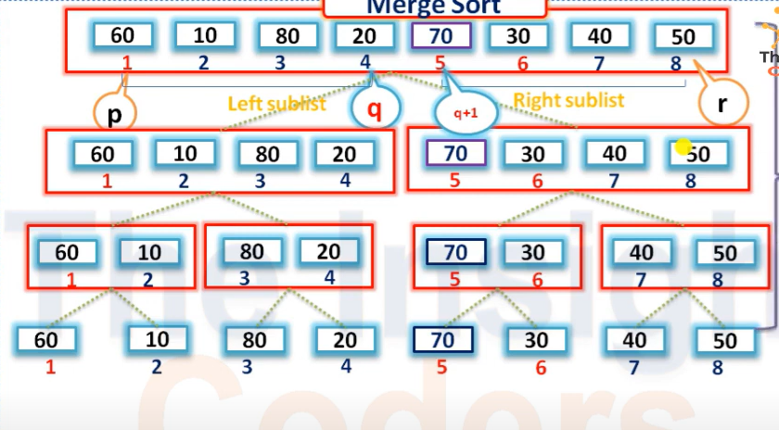
Merge Sort

Slide 64
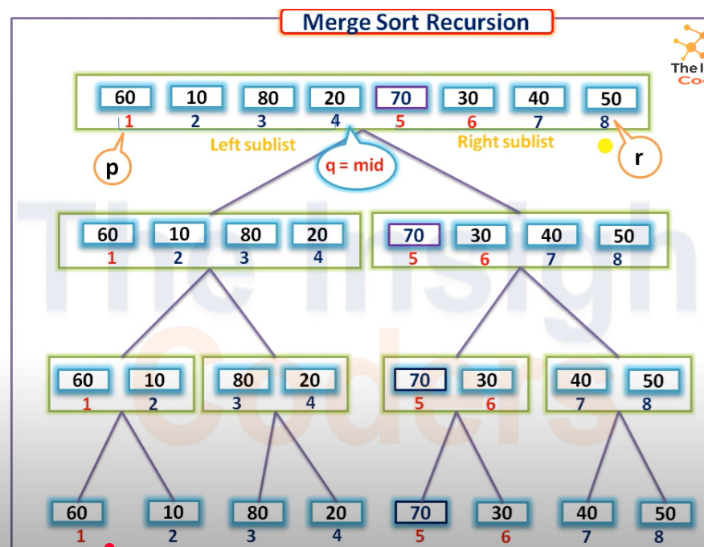

Slide 65
Quick Sort
QuickSort is a sorting algorithm based on the Divide and Conquer that picks an element as a pivot and partitions the given array around the picked pivot by placing the pivot in its correct position in the sorted array.

Slide 66
Quick Sort
How does QuickSort Algorithm work?
QuickSort works on the principle of divide and conquer, breaking down the problem into smaller sub-problems.
There are mainly three steps in the algorithm:
Choose a Pivot: Select an element from the array as the pivot. The choice of pivot can vary (e.g., first element, last element, random element, or median).

Slide 67
Quick Sort
Partition the Array: Rearrange the array around the pivot. After partitioning, all elements smaller than the pivot will be on its left, and all elements greater than the pivot will be on its right. The pivot is then in its correct position, and we obtain the index of the pivot.
Recursively Call: Recursively apply the same process to the two partitioned sub-arrays (left and right of the pivot).
Base Case: The recursion stops when there is only one element left in the sub-array, as a single element is already sorted.

Slide 68
Quick Sort
Choice of Pivot
There are many different choices for picking pivots.
Always pick the first (or last) element as a pivot. The below implementation picks the last element as pivot. The problem with this approach is it ends up in the worst case when array is already sorted.
Pick a random element as a pivot. This is a preferred approach because it does not have a pattern for which the worst case happens.
Pick the median element is pivot. This is an ideal approach in terms of time complexity as we can find median in linear time and the partition function will always divide the input array into two halves. But it takes more time on average as median finding has high constants.

Slide 69
In short
1.First Element
2.Last Element
3.Median Element
4.Random Element

Slide 70
Quick Sort
https://www.programiz.com/online-compiler/4UmBCGjTVZvZy

